Slide 1
LTI to Mamba: Legendre Memory Unit
Presenter: Kim Seung Hwan (overnap@khu.ac.kr)

Slide 2
What is Mamba?
Mamba is the new layer that beat Transformer, proposed recently
Originated from State-Space Model (SSM)
Generalizes recurrent model and (continuous-time) convolution
Gu, Albert, and Tri Dao. "Mamba: Linear-time sequence modeling with selective state spaces." arXiv preprint arXiv:2312.00752 (2023).

Slide 3
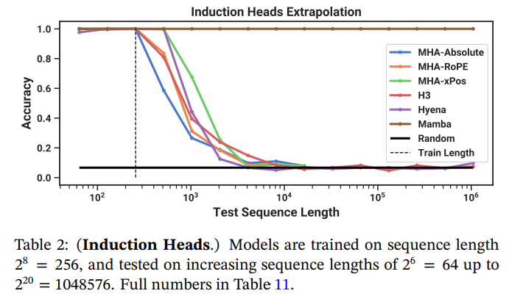
Performance of Mamba
MHA (multi-head attention)
xPos is designed for length extrapolation
H3 and Hyena are SSMs
Mamba is strong at long sequence

Slide 4
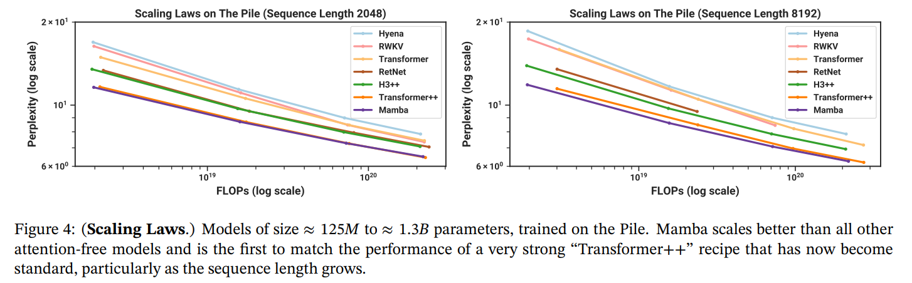
Performance of Mamba
Perplexity is the metric for NLP
(Geo mean of probability)
Mamba is strong at scaling

Slide 5
Flow of study (and seminar)
LTI
LMU
HiPPO
Mamba
Today’s topic

Slide 6

What is LTI?
Linear Time-invariant (LTI) System
Concept in signal processing and control engineering
Linearity and Time-invariance makes it simple and predictable
LTI assumption is conventional (even if it is not in reality!)
Basic logic control system
with feedback loop

Slide 7
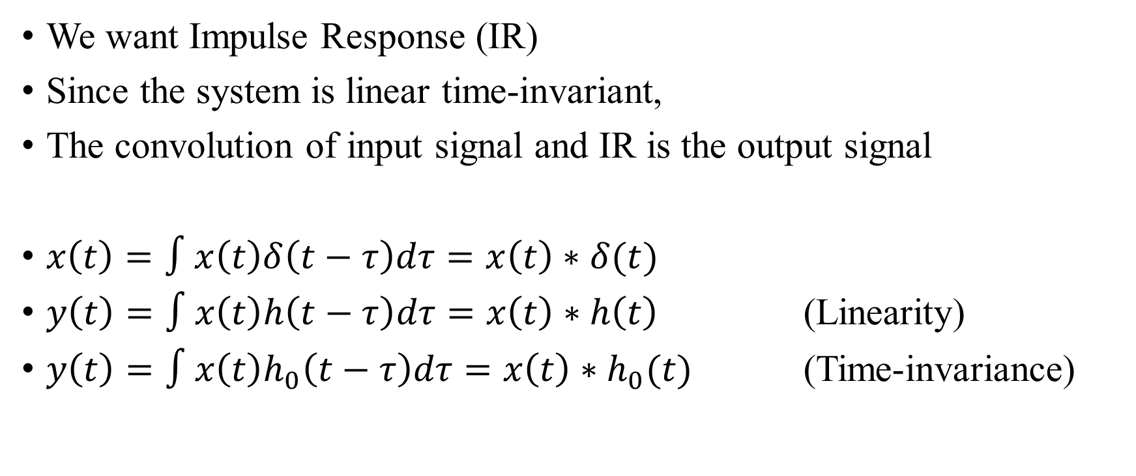
Impulse Response
We want Impulse Response (IR)
Since the system is linear time-invariant,
The convolution of input signal and IR is the output signal
$x\left(t\right)=∫x\left(t\right)δ\left(t−τ\right)dτ=x\left(t\right)∗δ(t)$
$y\left(t\right)=∫x\left(t\right)h\left(t−τ\right)dτ=x\left(t\right)∗h\left(t\right)$ (Linearity)
$y\left(t\right)=∫x\left(t\right)h_{0}\left(t−τ\right)dτ=x\left(t\right)∗h_{0}(t)$ (Time-invariance)

Slide 8
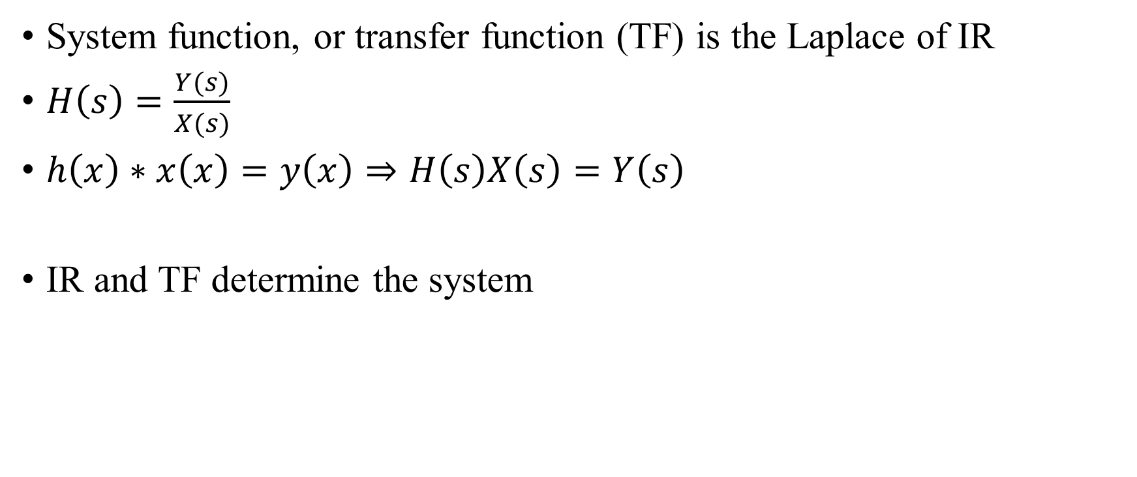
Transfer function
System function, or transfer function (TF) is the Laplace of IR
$H\left(s\right)=\frac{Y(s)}{X(s)}$
$h\left(x\right)∗x\left(x\right)=y\left(x\right)⇒H\left(s\right)X\left(s\right)=Y\left(s\right)$
IR and TF determine the system

Slide 9
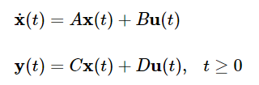
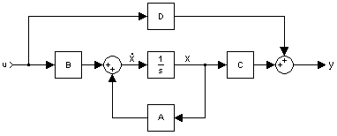

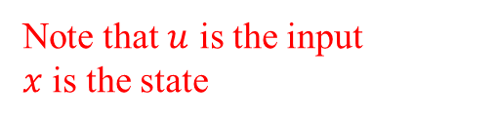
State-Space Model
All LTI system can be represented by state-space equation
So, IR <=> TF (classical, harmonic) <=> SSM (analytic)
This is $x^{′}=dx/dt$
Note that $u$ is the input
$x$ is the state
This is a very naïve claim
We must consider the conditions and uniqueness, right?
But skip them in this seminar

Slide 10
Legendre Memory Unit
We are finally here: Legendre Memory Unit (LMU)
Voelker, Aaron, Ivana Kajić, and Chris Eliasmith. "Legendre memory units: Continuous-time representation in recurrent neural networks." Advances in neural information processing systems 32 (2019).

Slide 11
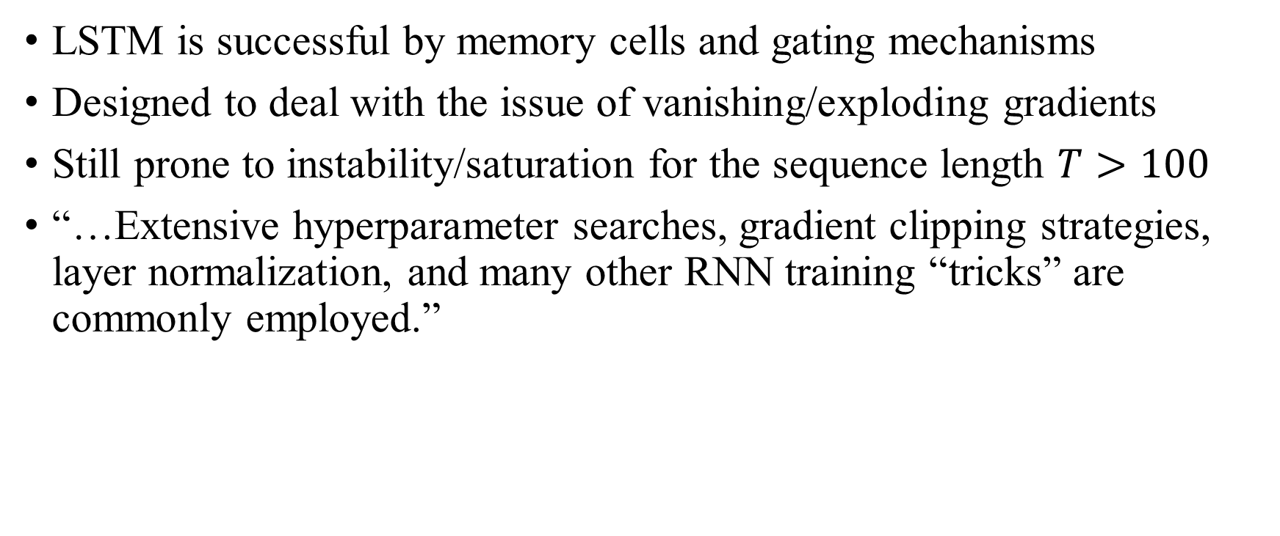
Introduction: Problems
LSTM is successful by memory cells and gating mechanisms
Designed to deal with the issue of vanishing/exploding gradients
Still prone to instability/saturation for the sequence length $T>100$
“…Extensive hyperparameter searches, gradient clipping strategies, layer normalization, and many other RNN training “tricks” are commonly employed.”

Slide 12

Introduction: Problems
Standard LSTMs with saturating units have memory $T∈[500,1000]$
RNNs with non-saturating units may have memory $T∈[2000,5000]$
Signals in reality, is continuous, thus have $T→∞$
How can RNN handle it?

Slide 13
Introduction: Ideas
Intuition from biological nervous systems
Processing of continuous-time information – spike delay network
“This model reproduces properties of “time cells” observed in the hippocampus, striatum, and cortex…”

Slide 14
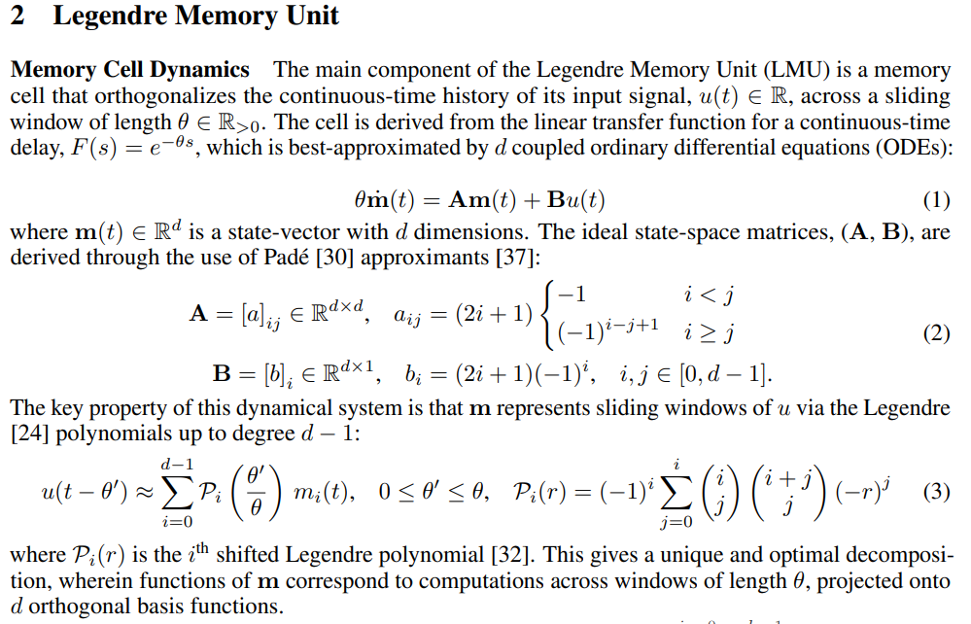
Method
This is the all of LMU!
Let us interpret one by one

Slide 15
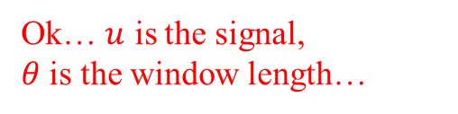
Method
Ok… $u$ is the signal,
$θ$ is the window length…

Slide 16
Method
???????

Slide 17
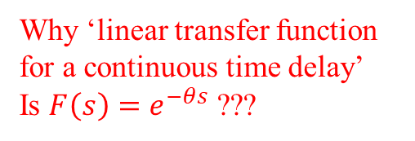
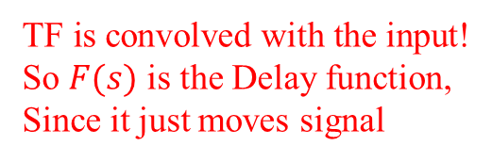
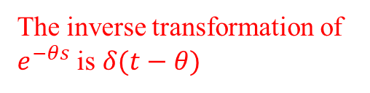
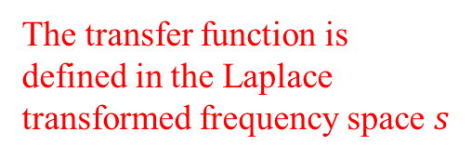
Method
Why ‘linear transfer function for a continuous time delay’
Is $F\left(s\right)=e^{−θs}$ ???
The transfer function is defined in the Laplace transformed frequency space $s$
The inverse transformation of $e^{−θs}$ is $δ(t−θ)$
TF is convolved with the input!
So $F(s)$ is the Delay function,
Since it just moves signal
Is this an engineering math review? 😭

Slide 18
Method
Why ‘linear’?
Because it is approximated
Why ‘best-approximated’?
Let us skip it for now

Slide 19
Method
Delay TF does not need to be approximated like this
Remember what we talked about earlier slide: uniqueness
So why?
Here is why

Slide 20
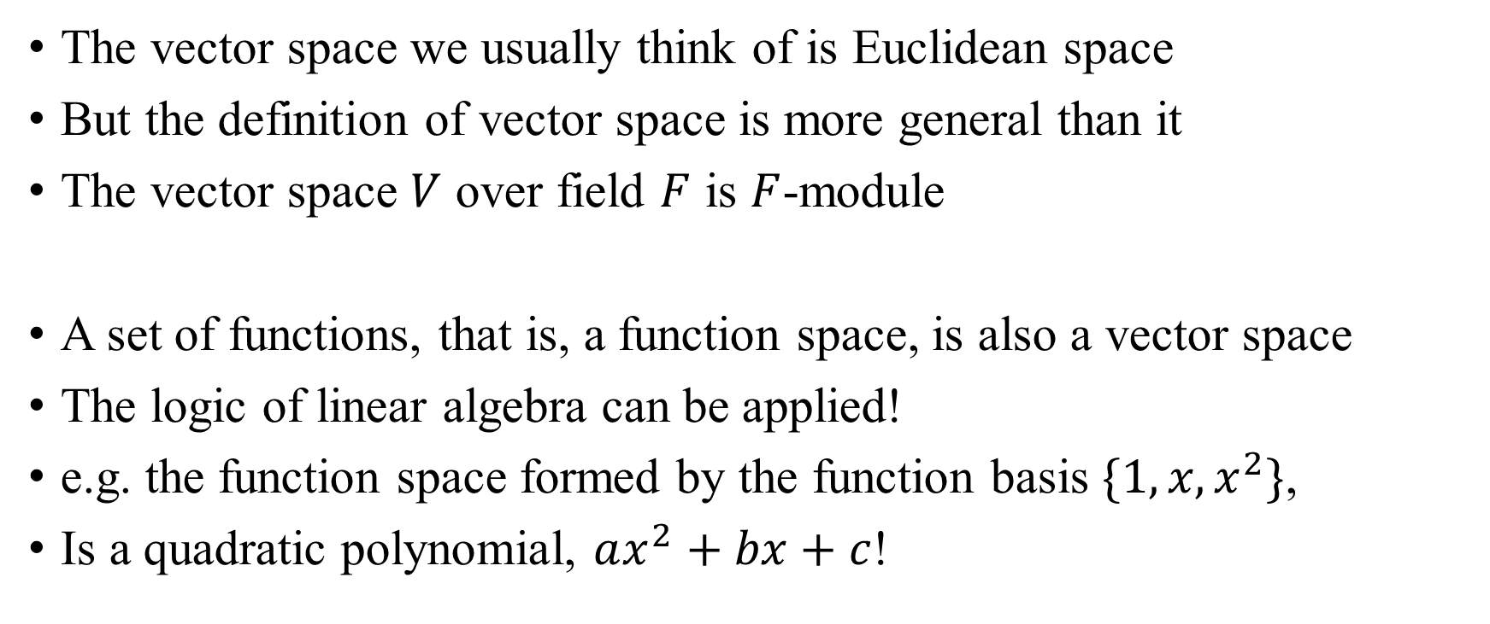
Side: Basis Function?
The vector space we usually think of is Euclidean space
But the definition of vector space is more general than it
The vector space $V$ over field $F$ is $F$-module
A set of functions, that is, a function space, is also a vector space
The logic of linear algebra can be applied!
e.g. the function space formed by the function basis $\{1, x, x^{2}\}$,
Is a quadratic polynomial, $ax^{2}+bx+c$!
If you are interested in this type of expression, see modern algebra or group theory

Slide 21
Method
Therefore, LMU is an SSM expansion of the delay function so that the state space follows the Legendre polynomial basis

Slide 22
Why LTI?
There is no explicit mention other than previous works
My speculation:
Since it is expressed as a matrix, it is easy to apply to neural net
SS representation of LTI favors multiple inputs and multiple outputs
I think it is just because it is a very advantageous trait

Slide 23
Why Optimal?
Best approximated ???
Hm… Ok, the projection to the orthogonal basis is optimal decomposition (for a given basis)
But I think it means stronger than that

Slide 24
Why Optimal?
Let us go through the references
The previous work: Spike Delay Network
Voelker, Aaron R., and Chris Eliasmith. "Improving spiking dynamical networks: Accurate delays, higher-order synapses, and time cells." Neural computation 30.3 (2018): 569-609.
Same author

Slide 25
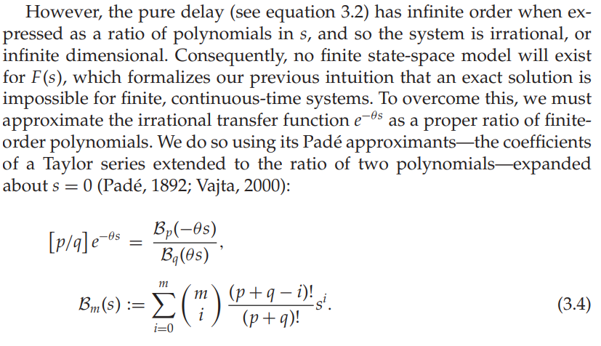
Why Optimal? (Neural Computation)
The use of LTI seems to be conventional...
Again, following from previous studies
For the optimal issue…
I understand the problems
So where is the optimality?!!?

Slide 26
Why Optimal? (Neural Computation)
The Padé approximation is widely used in computers indeed
But I do not know if it is really optimal
Let us find out more
Go to the more previous work…

Slide 27
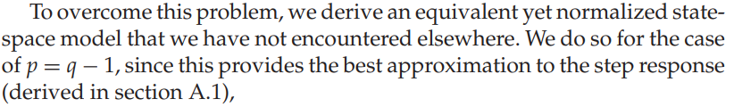
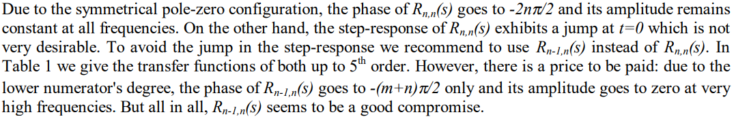

Why Optimal? (Padé)
Vajta, Miklos. "Some remarks on Padé-approximations." Proceedings of the 3rd TEMPUS-INTCOM Symposium. Vol. 242. 2000.
This paper claims: $R_{n−1,n}(s)$ is better than $R_{n,n}(s)$ for approx. $e^{−sT}$
Ah, at least we now know why $p=q−1$in neural computation paper

Slide 28
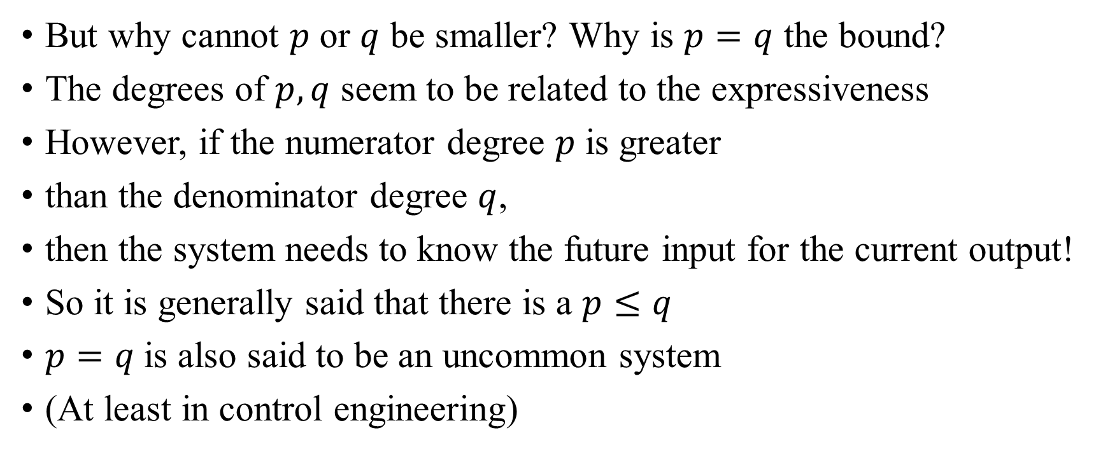
Why Optimal? (Padé)
But why cannot $p$ or $q$ be smaller? Why is $p=q$ the bound?
The degrees of $p,q$ seem to be related to the expressiveness
However, if the numerator degree $p$ is greater
than the denominator degree $q$,
then the system needs to know the future input for the current output!
So it is generally said that there is a $p≤q$
$p=q$is also said to be an uncommon system
(At least in control engineering)
Verification required!

Slide 29
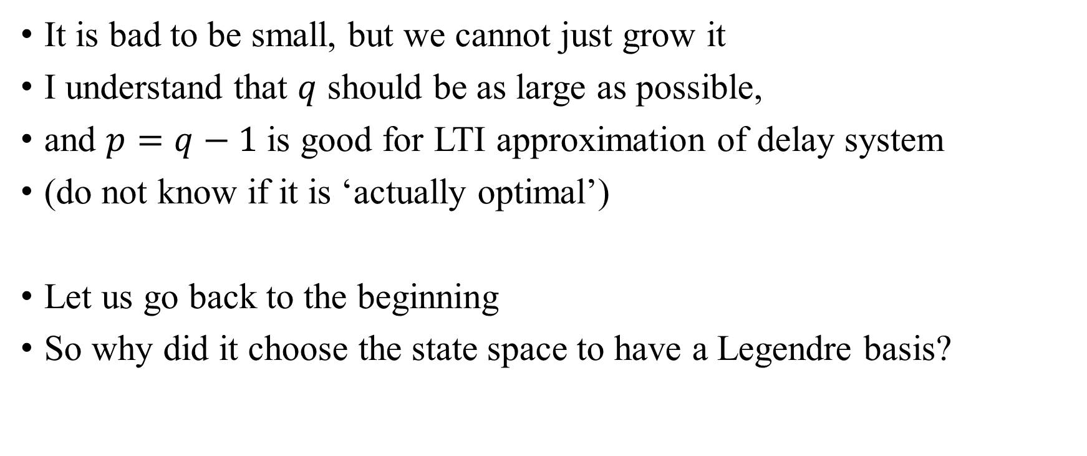
Why Optimal? (Legendre)
It is bad to be small, but we cannot just grow it
I understand that $q$ should be as large as possible,
and $p=q−1$ is good for LTI approximation of delay system
(do not know if it is ‘actually optimal’)
Let us go back to the beginning
So why did it choose the state space to have a Legendre basis?

Slide 30
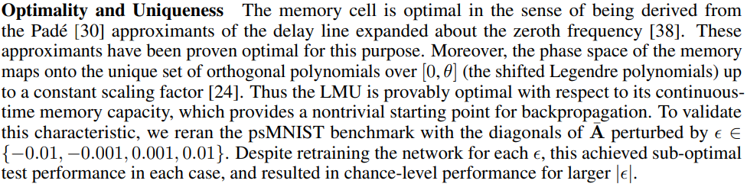
Why Optimal? (Legendre)
This is the only explanation of optimality in the paper
Since Legendre basis is orthogonal and experimentally perform well

Slide 31
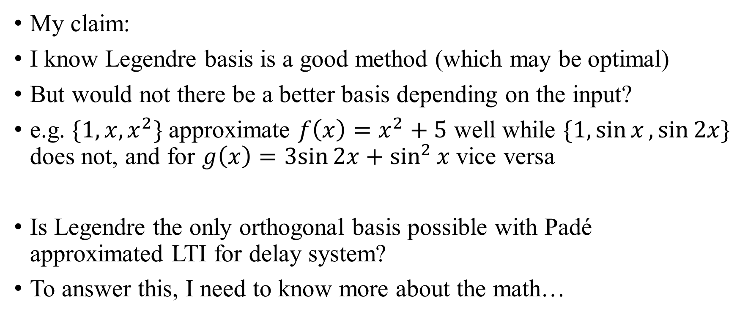
Discussion
My claim:
I know Legendre basis is a good method (which may be optimal)
But would not there be a better basis depending on the input?
e.g. $\{1,x,x^{2}\}$ approximate ${f\left(x\right)=x}^{2}+5$ well while $\{1,\sin{x},\sin{2x}\}$ does not, and for $g\left(x\right)=3sin{2x}+\sin^{2}{x}$ vice versa
Is Legendre the only orthogonal basis possible with Padé approximated LTI for delay system?
To answer this, I need to know more about the math…

Slide 32
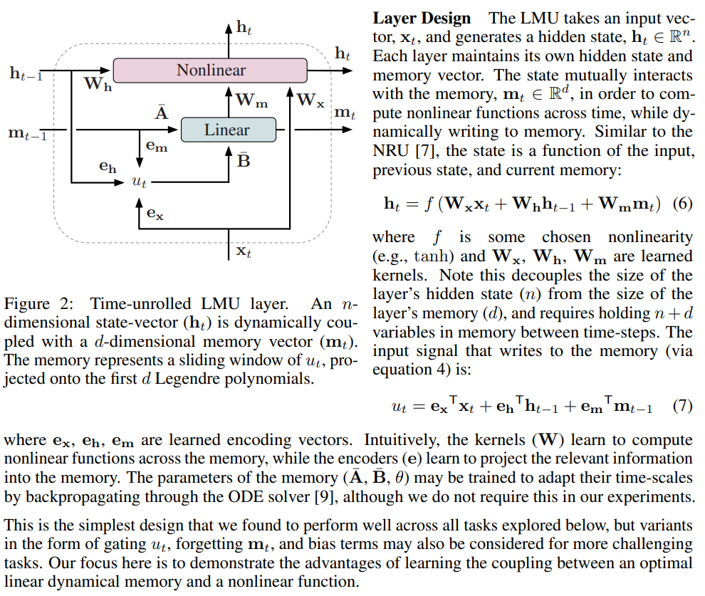
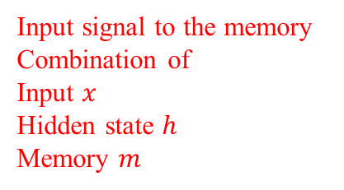
Implementation
Very similar structure to
a simple RNN or LSTM
Input signal to the memory
Combination of
Input $x$
Hidden state $h$
Memory $m$

Slide 33
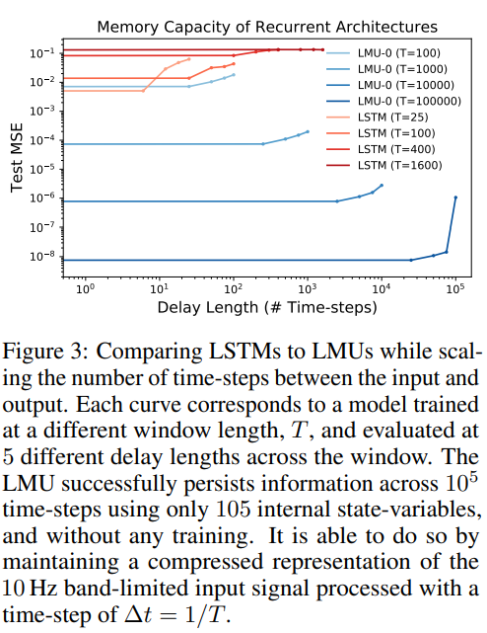
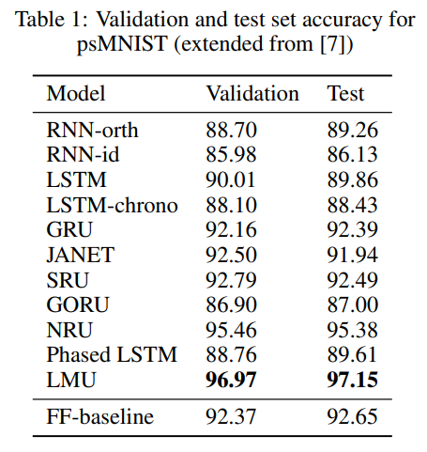
Results

Slide 34
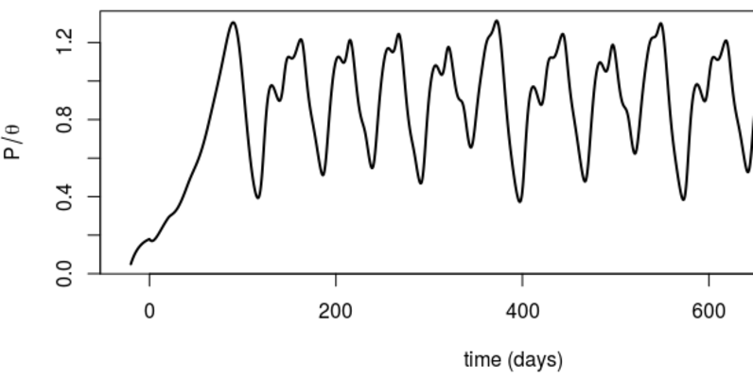
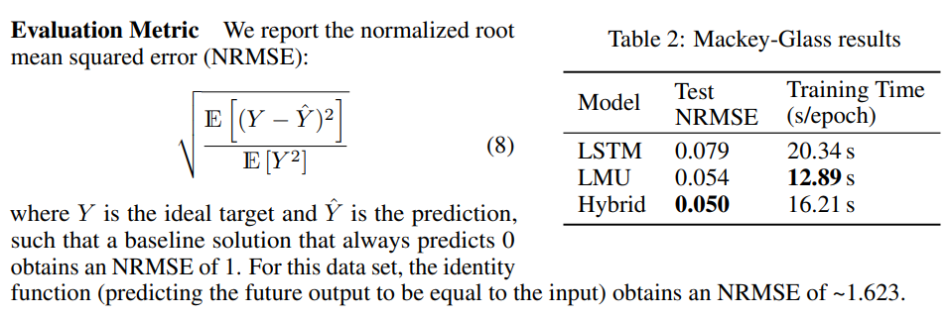
Results

Slide 35
Thank you for listening
Presenter: Kim Seung Hwan (overnap@khu.ac.kr)

